Slide 1
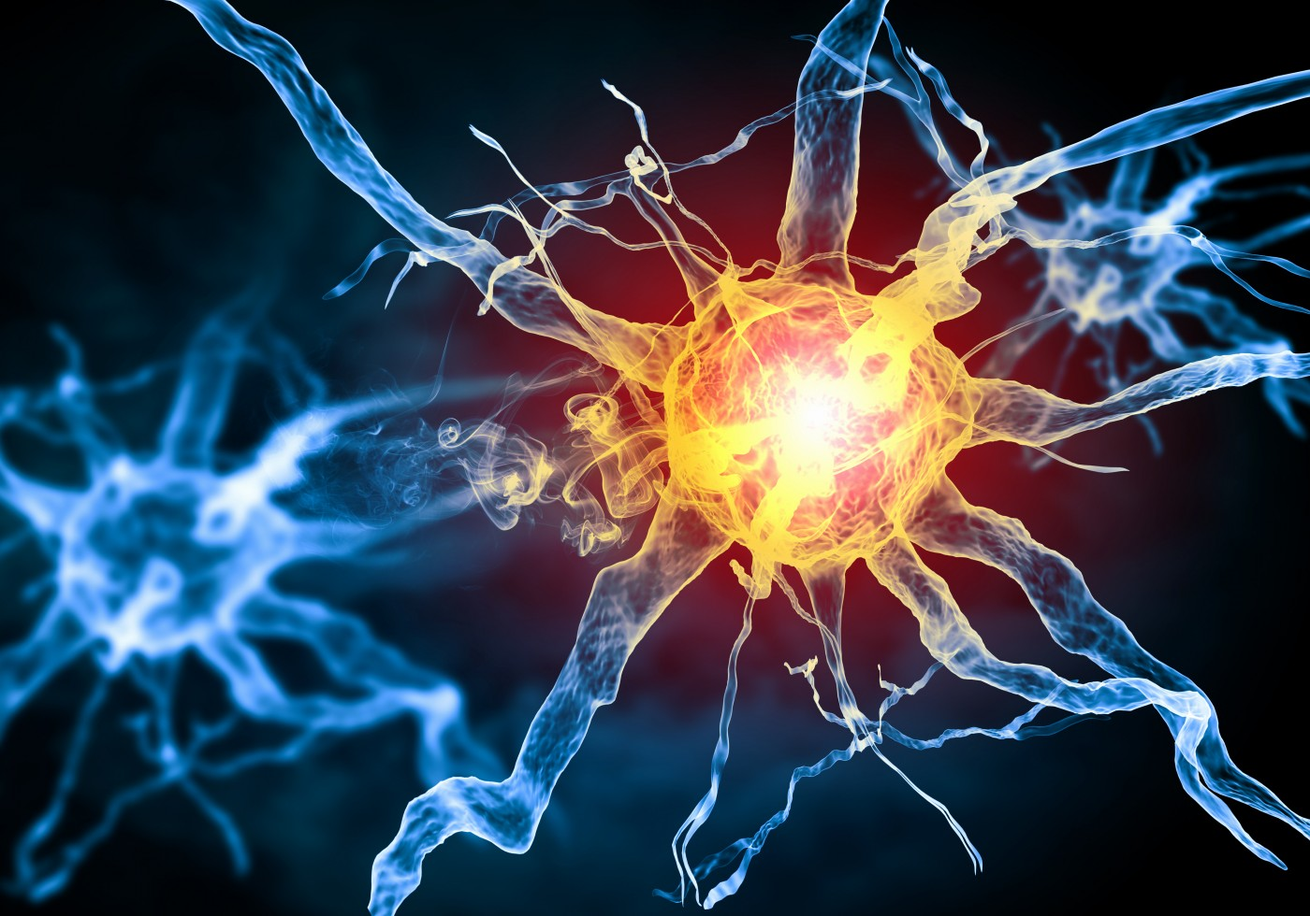

Multiple Sclerosis and liver X receptor alpha
Will Richards

Slide 2
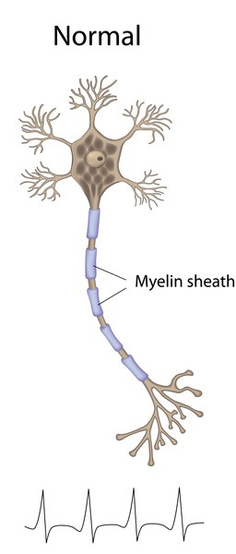
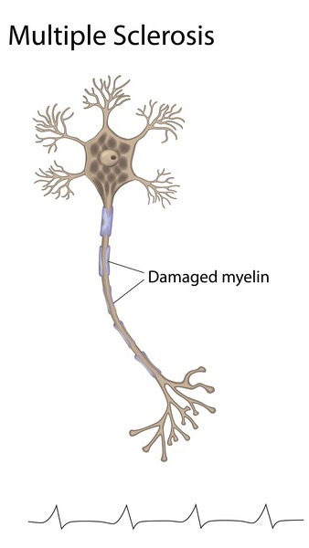
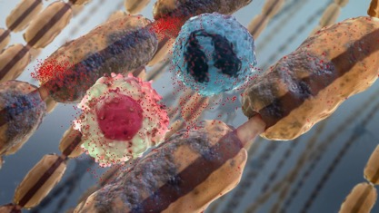
Multiple Sclerosis (MS)
An autoimmune disorder that attacks myelin sheaths

Slide 3
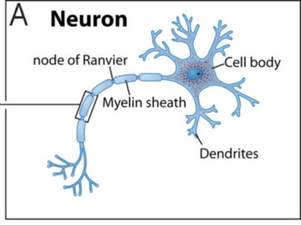
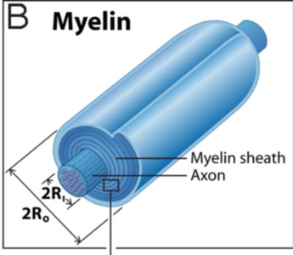
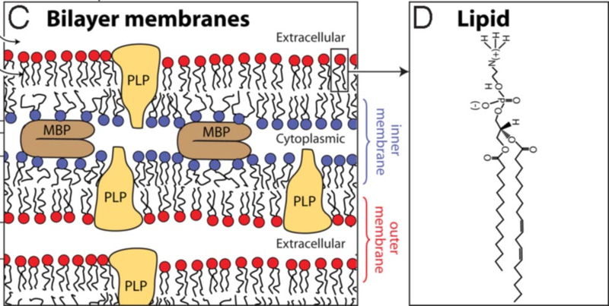
Myelin sheath composition
Notes:
Talk about what about the myelin sheath is important in LXRA (Lipid)

Slide 4
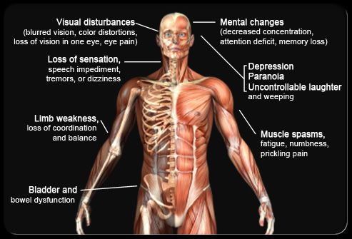
Symptoms of MS

Slide 5

First hand experience

Slide 6
MS associated gene
LXRA
447 AA
Zinc Finger Domain
Ligand Binding Domain
Biological Process
Molecular Function
Cellular Component
- Lipid Homeostasis
- Inflammation
- Innate Immunity
- DNA Binding
- Protein Binding
- Hormone Receptor
- Nucleus

Slide 7
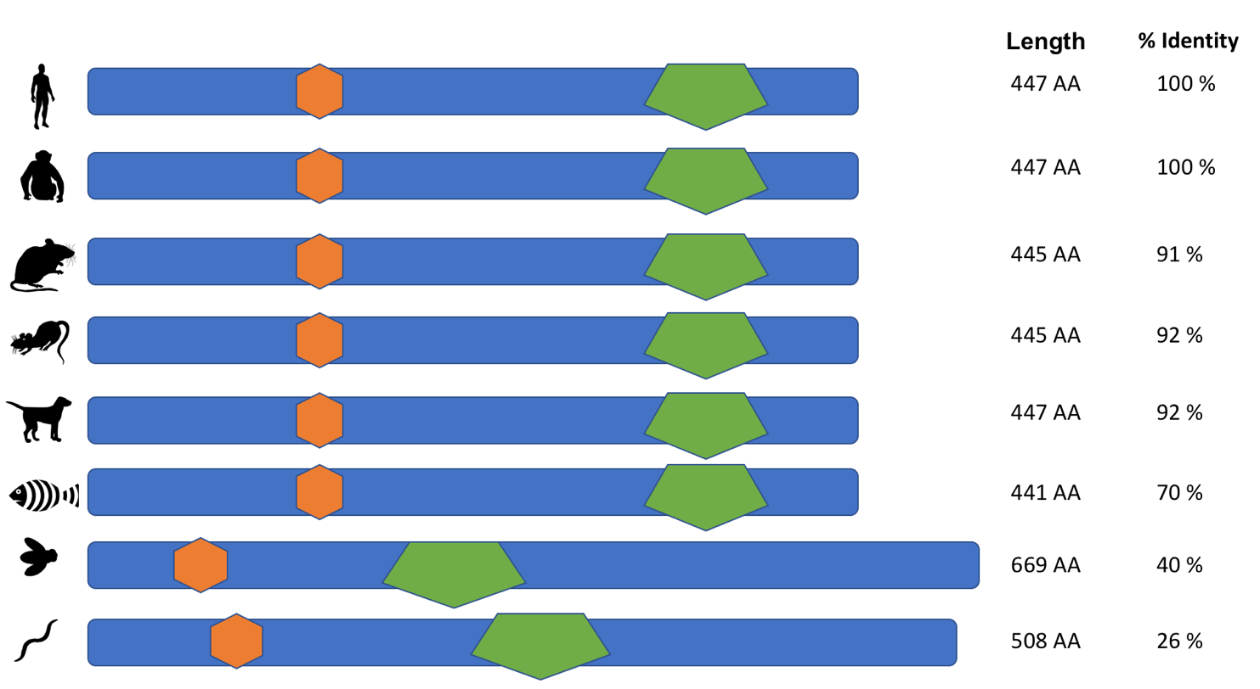
LXRA throughout time
Zinc finger domain
Ligand binding domain

Slide 8
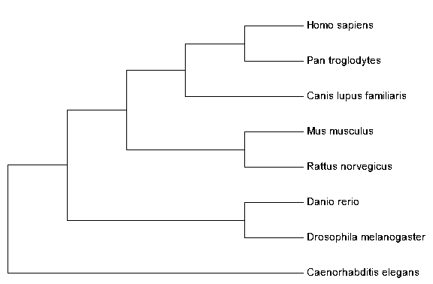
What is the phylogeny of LXRA?

Slide 9
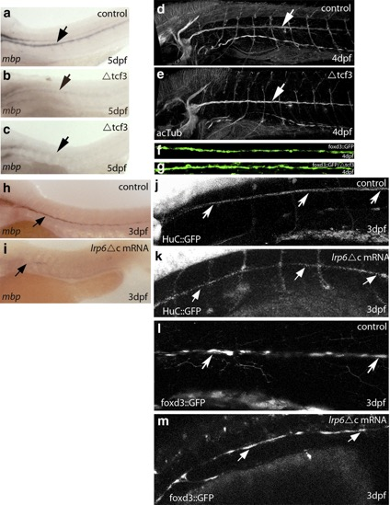
Why zebrafish and mice?
-Genetic similarity
-Transparent
-Quick development
-High throughput
-Can study myelination
-Genetic similarity
-Disease model for demyelination (EAE)
-Can study myelination

Slide 10
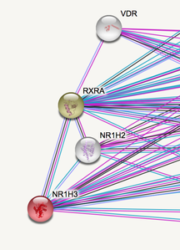
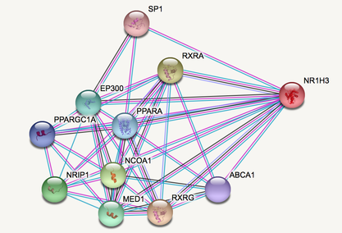
What proteins does LXRA interact with?
Interacts with RXR to mediate retinoid response

Slide 11
What is the overall goal?
LXRA
?
To understand the role LXRA has in myelination of nerves.
Notes:
https://en.wikipedia.org/wiki/Myelin

Slide 12

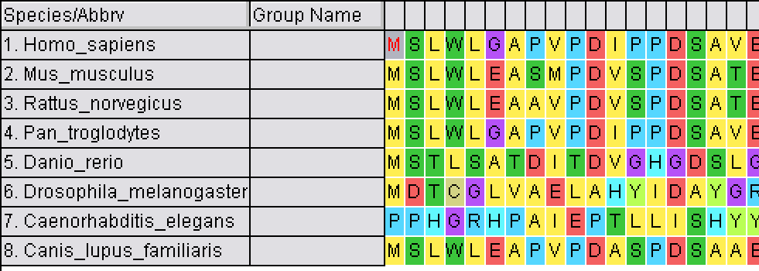
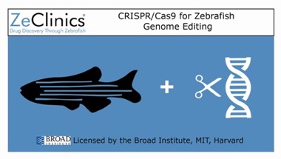
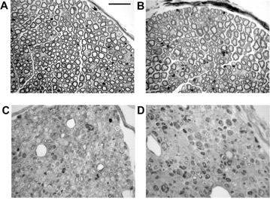
Aim 1: Identify important conserved amino acids for myelination
Notes:
Knocking out different amino acids in the ligand and showing which affects myelination can help determine which ones are critical

Slide 13
Aim 1: Identify important conserved amino acids for myelination
Notes:
Knocking out different amino acids in the ligand and showing which affects myelination can help determine which ones are critical

Slide 14
Aim 1: Identify important conserved amino acids for myelination
Hypothesis: Mutation of amino acids in the ligand binding domain show a reduction of myelination
Notes:
Knocking out different amino acids in the ligand and showing which affects myelination can help determine which ones are critical

Slide 15
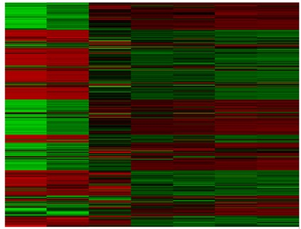



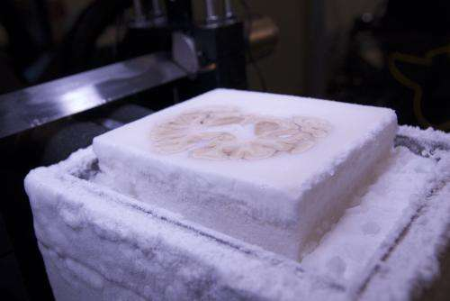
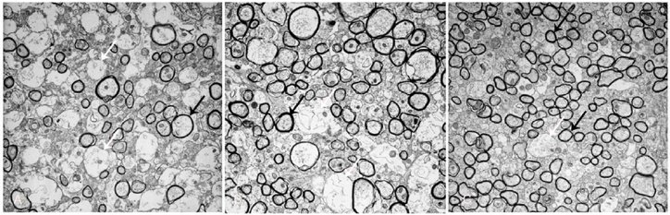
Aim 2: Characterize differentially expressed genes in the CNS in LXRA deficient mice

Slide 16
Aim 2: Characterize differentially expressed genes in the CNS in LXRA deficient mice

Slide 17
Aim 2: Characterize differentially expressed genes in the CNS in LXRA deficient mice
Hypothesis: Genes involved in lipid homeostasis will be downregulated

Slide 18
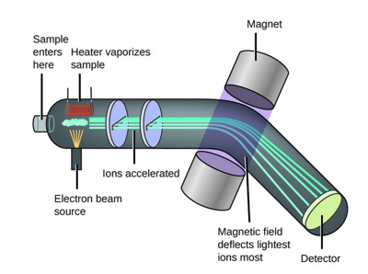
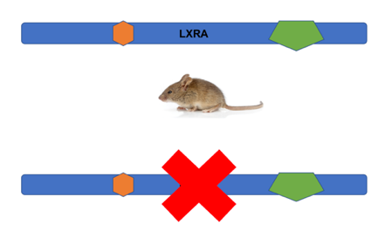
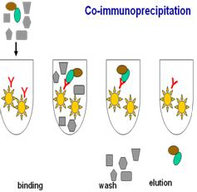

Aim 3: Determine protein interactions that differ between WT and LXRA mutant mice

Slide 19
Aim 3: Determine protein interactions that differ between WT and LXRA mutant mice

Slide 20
Aim 3: Determine protein interactions that differ between WT and LXRA mutant mice
Hypothesis: LXRA interacts with genes involved in lipid homeostasis in WT but not mutant

Slide 21


Future Directions
Determine the role of LXRA in Vitamin D deficiency in MS patients
Determine if LXRA targeting is a possible drug therapy

Slide 22
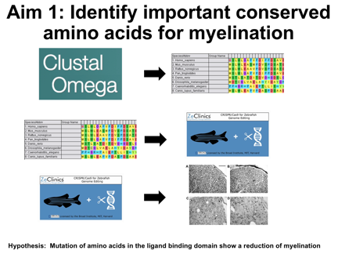
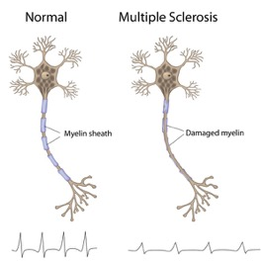
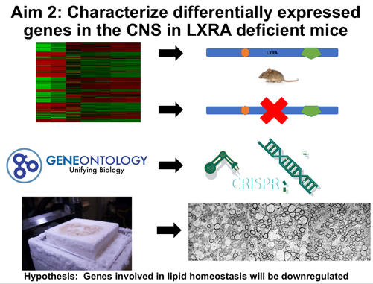
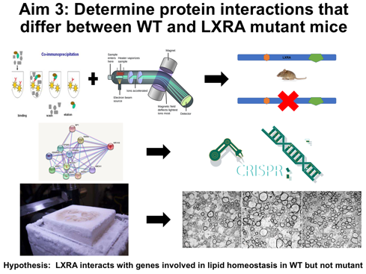
Multiple Sclerosis and LXRA
Demyelination
Aim 1
Aim 2
Aim 3

Slide 23
References
https://karandikar.lab.uiowa.edu/eae-modeling-cd8-function
https://www.researchgate.net/figure/Analysis-of-Schwann-cell-myelination-in-TCF3-zebrafish-embryos-and-after-LRP6-knockdown_fig6_50351282
http://biotech-spain.com/en/articles/crispr-cas9-uses-for-zebrafish-targeted-mutagenesis-and-genome-editing/
http://www.jneurosci.org/content/28/44/11292/tab-figures-data
https://www.rna-seqblog.com/quality-assessment-and-control-of-tissue-specific-rna-seq-libraries/
http://www.norwestpest.com/pest-library/house-mouse
http://www.geneontology.org/page/go-citation-policy
https://www.elsevier.com/research-intelligence/campaigns/crispr
https://www.researchgate.net/figure/EM-shows-more-myelinated-axons-in-rhGas6-treated-mice-Relative-to-PBS-A-the-number-of_fig5_49726215
https://medicalxpress.com/news/2014-01-histological-sectioning-digital-3d-reconstruction.html
http://www.hanbio.net/en/services/item/528
https://chemistry.stackexchange.com/questions/74711/how-exactly-are-ions-in-a-mass-spectrometer-accelerated
https://www.quickanddirtytips.com/relationships/professional/how-to-deal-with-people-who-ask-lots-of-questions
https://www.illumina.com/areas-of-interest/genomics-in-drug-development/ngs-for-drug-development/rna-biomarker-discovery-profiling.html
https://betterhealthwhileaging.net/vitamin-d-healthy-aging-dose-faqs/
Wang, Z., Sadovnick, A. D., Traboulsee, A. L., Ross, J. P., Bernales, C. Q., Encarnacion, M., … Vilariño-Güell, C. (2016). Nuclear receptor NR1H3 in familial multiple sclerosis. Neuron, 90(5), 948–954. http://doi.org/10.1016/j.neuron.2016.04.039

Slide 24

Questions?

