Slide 1
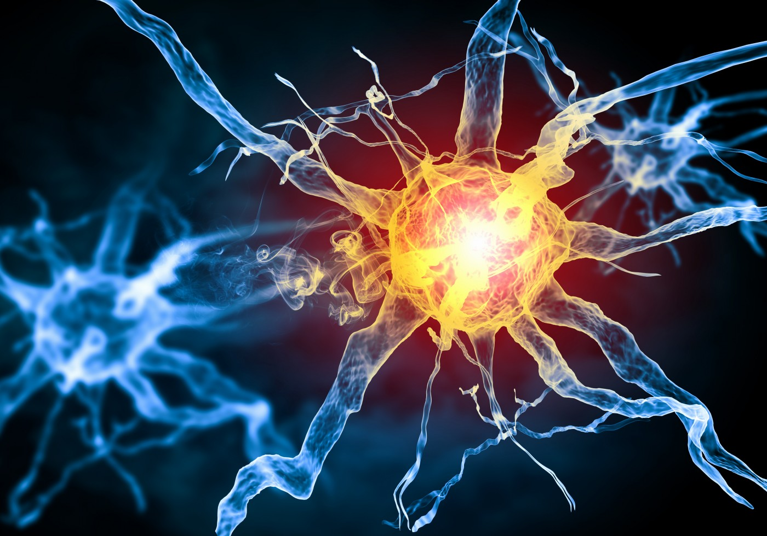
Multiple Sclerosis
Will Richards

Slide 2
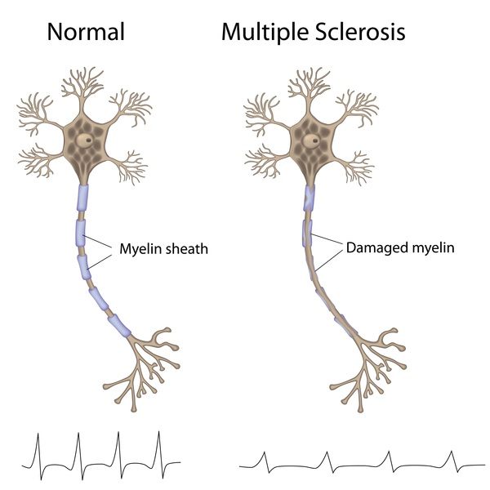
What is Multiple Sclerosis (MS)?
An autoimmune disorder that attacks myelin sheaths

Slide 3
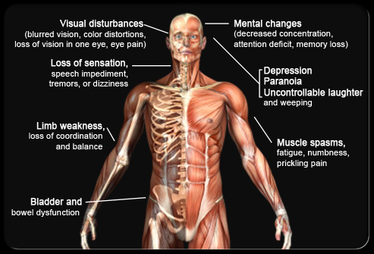
What are the symptoms of MS?

Slide 4
What gene plays a role in MS?
LXRA
447 AA
Zinc Finger Domain
Ligand Binding Domain
Biological Process
Molecular Function
Cellular Component
- Lipid Homeostasis
- Inflammation
- Innate Immunity
- DNA Binding
- Protein Binding
- Hormone Receptor
- Nucleus

Slide 5
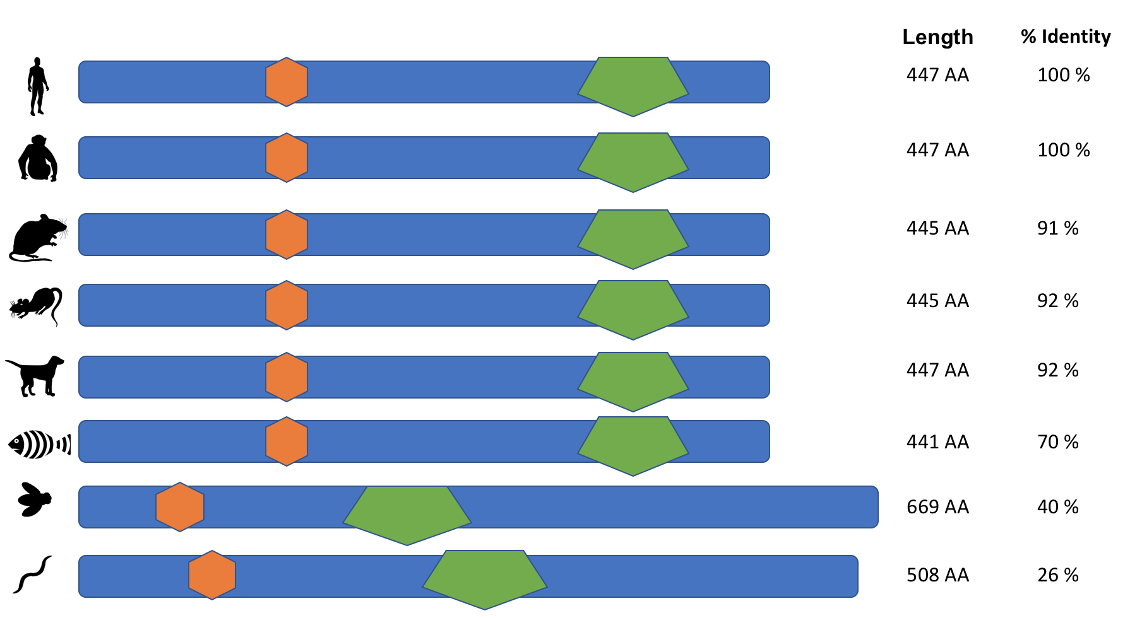
How conserved is LXRA?

Slide 6
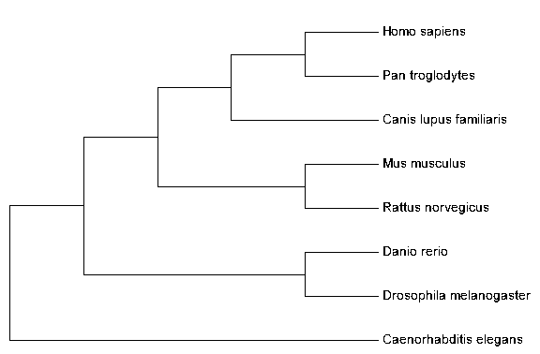
What is the phylogeny of LXRA?

Slide 7
What proteins does LXRA interact with?
Finish later

Slide 8
What is the primary goal?
To understand the role LXRA has in myelination of nerves.
Better image here

Slide 9
Aim 1: Identify important conserved amino acids for myelination
Finalize aim before adding to presentation

Slide 10
Aim 2
Rework aim 2 before adding into presentation

