Slide 1
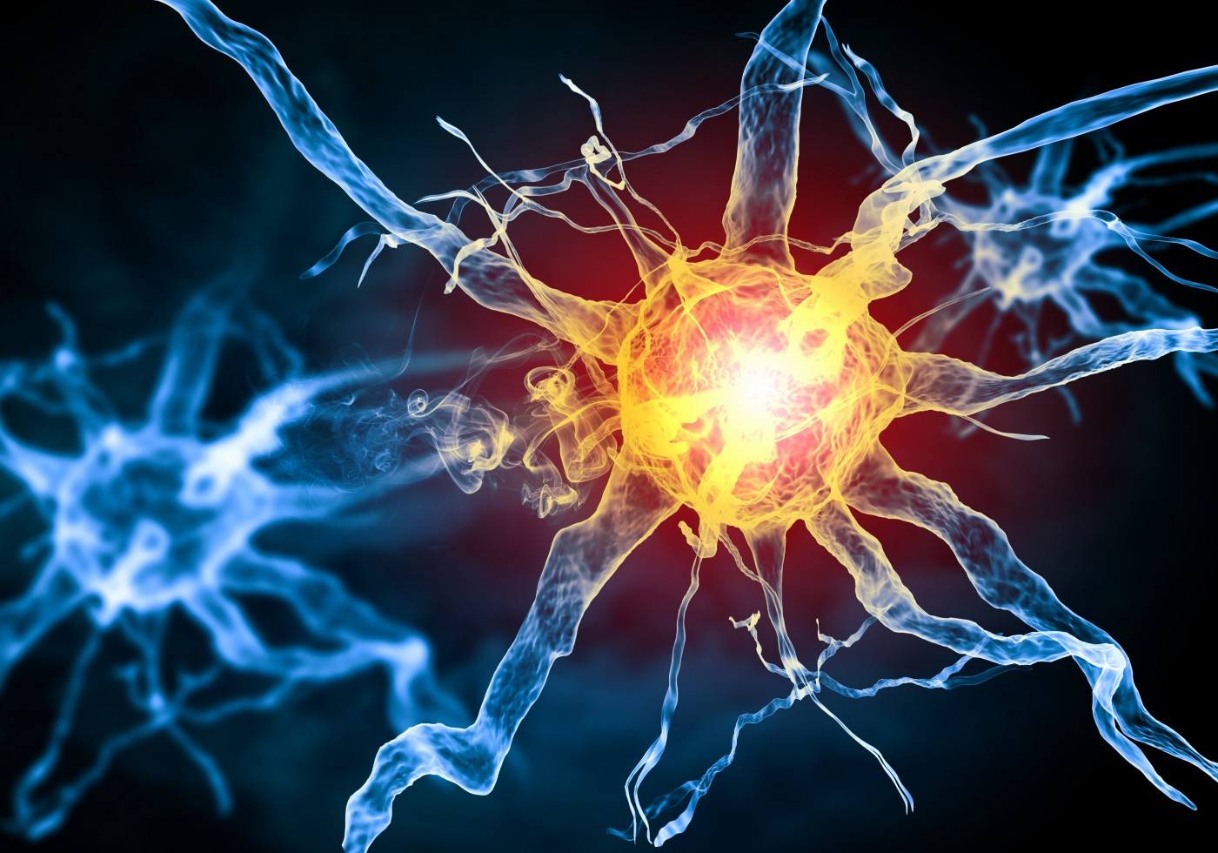
Multiple Sclerosis and liver X receptor alpha
Will Richards

Slide 2
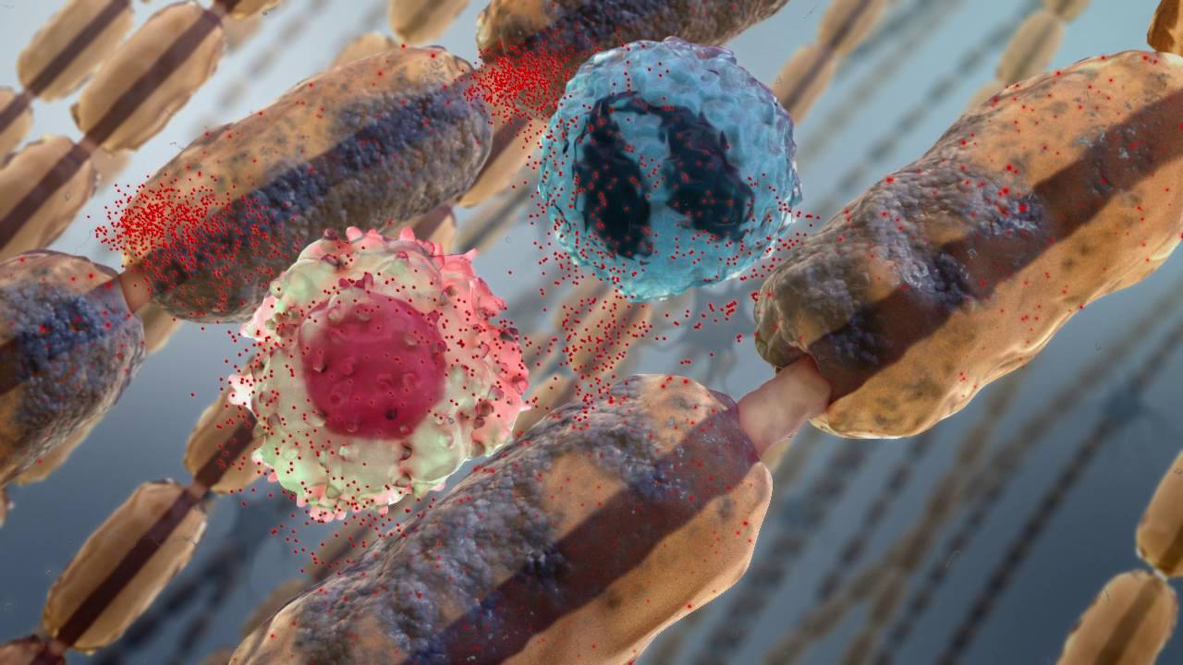
Multiple Sclerosis (MS)
An autoimmune disorder that attacks myelin sheaths

Slide 3
Myelin sheath composition
Notes:
Talk about what about the myelin sheath is important in LXRA (Lipid)

Slide 4
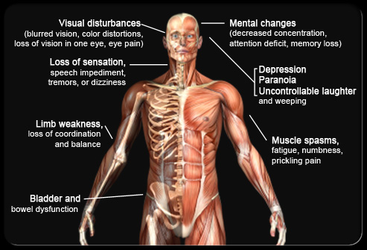
Symptoms of MS

Slide 5
MS associated gene
LXRA
447 AA
Zinc Finger Domain
Ligand Binding Domain
Biological Process
Molecular Function
Cellular Component
- Lipid Homeostasis
- Inflammation
- Innate Immunity
- DNA Binding
- Protein Binding
- Hormone Receptor
- Nucleus

Slide 6
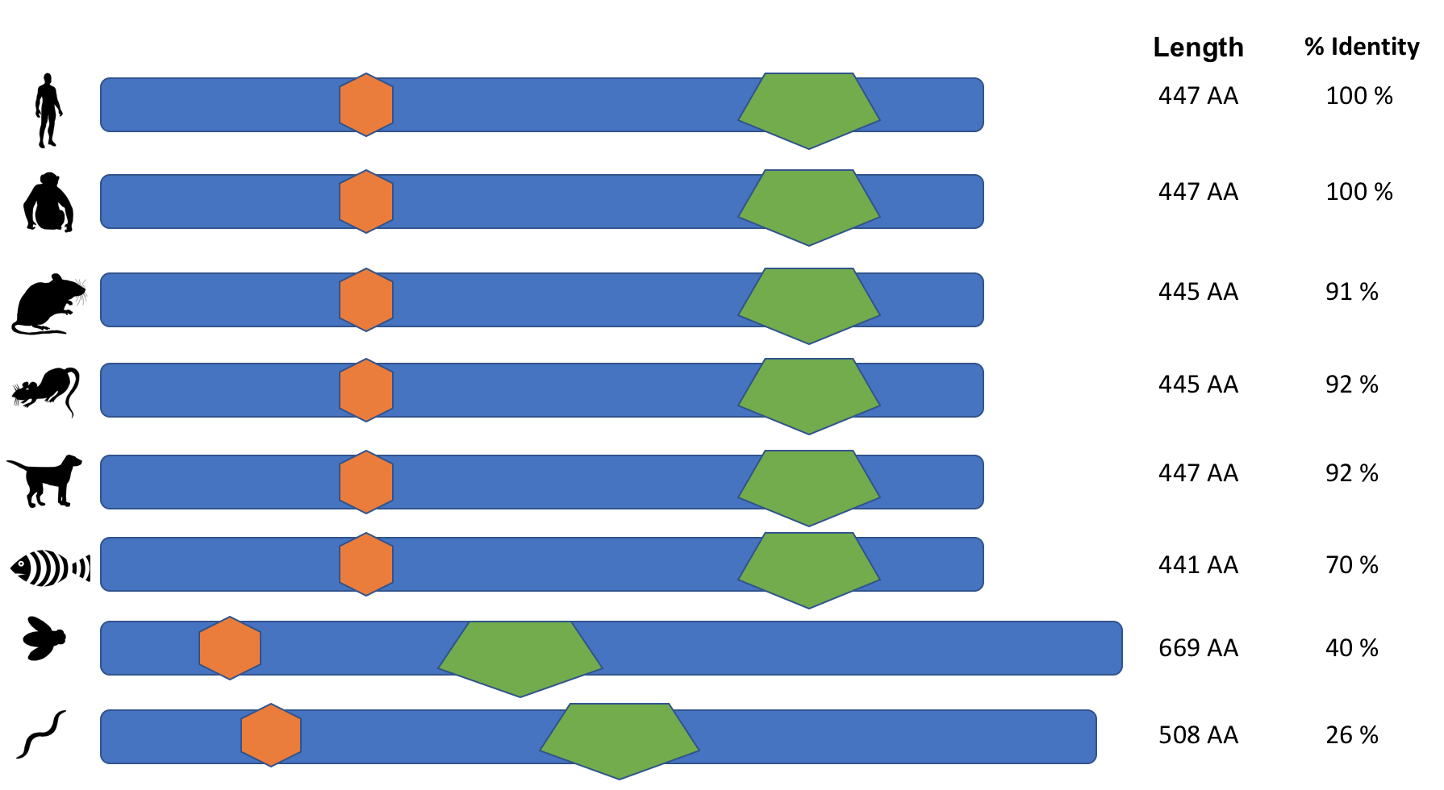
LXRA throughout time

Slide 7
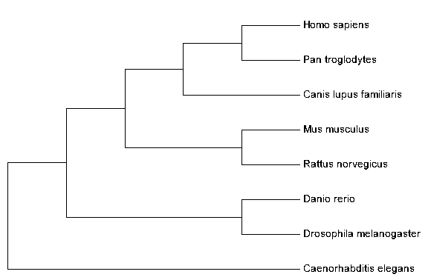
What is the phylogeny of LXRA?

Slide 8
What proteins does LXRA interact with?
Finish later

Slide 9
What is the primary goal?
To understand the role LXRA has in myelination of nerves.
Better image here

Slide 10
Aim 1: Identify important conserved amino acids for myelination
Finalize aim before adding to presentation

Slide 11
Aim 2
Rework aim 2 before adding into presentation

Slide 12
Multiple Sclerosis and LXRA
Demyelination
Aim 3
Aim 2
Aim 1

